Slide 1
MERN Stack Bootcamp · Week 2 · Day 5
Functional JavaScript
Mastering Higher-Order Array Methods
map · filter · some · every · find · reduce · sort
Instructor
Duration
Abid Ali
90 minutes (lecture)
Prereq: JS engine · event loop · callbacks · Promises · async/await

Slide 2
Day 5 — Functional JavaScript: Higher-Order Array Methods
Week 2 · Day 5
Agenda (90 min)
• 1. Recap — functions as first-class citizens (10 min)
• 2. Imperative vs declarative (10 min)
• 3. forEach — iteration without a result (5 min)
• 4. map — transform each element (15 min)
• 5. filter — keep what passes a test (15 min)
• 6. some & every — quick boolean answers (10 min)
• 7. find & findIndex — the first match (5 min)
• 8. reduce — the Swiss Army knife (15 min)
• 9. sort — ordering (carefully!) (10 min)
• 10. Chaining — real data pipelines (10 min)
• 11. Performance, pitfalls & cheat-sheet (5 min)
Today we turn everything we learned about callbacks & async into clean, declarative data pipelines you will use every day in the MERN stack.
MERN Stack Bootcamp · Instructor: Abid Ali
2 / 25

Slide 3
Day 5 — Functional JavaScript: Higher-Order Array Methods
Week 2 · Day 5
Where we are in the journey
• Week 1 — what powers JS: the engine & the event loop.
• Week 2 Day 3–4 — taming async: callbacks → Promises → async/await.
• Today — zoom BACK UP to everyday tools: higher-order array methods.
• These methods are the bread and butter of every React component, every Express handler, every Mongo query transformation.
Yesterday: async/await removed callback-hell INDENTATION. Today: array methods remove for-loop NOISE.
MERN Stack Bootcamp · Instructor: Abid Ali
3 / 25

Slide 4
Day 5 — Functional JavaScript: Higher-Order Array Methods
Week 2 · Day 5
By the end of this lecture, you will be able to…
• Explain why JS functions are FIRST-CLASS and what a higher-order function is.
• Choose between map, filter, find, some, every, reduce and sort for any data-transformation task.
• Chain these methods into clean, declarative data pipelines.
• Recognise the classic bugs: missing return in map, mutating sort, forgotten initial value in reduce, forEach + async.
• Decide when a plain old for loop is still the right tool.
MERN Stack Bootcamp · Instructor: Abid Ali
4 / 25

Slide 5
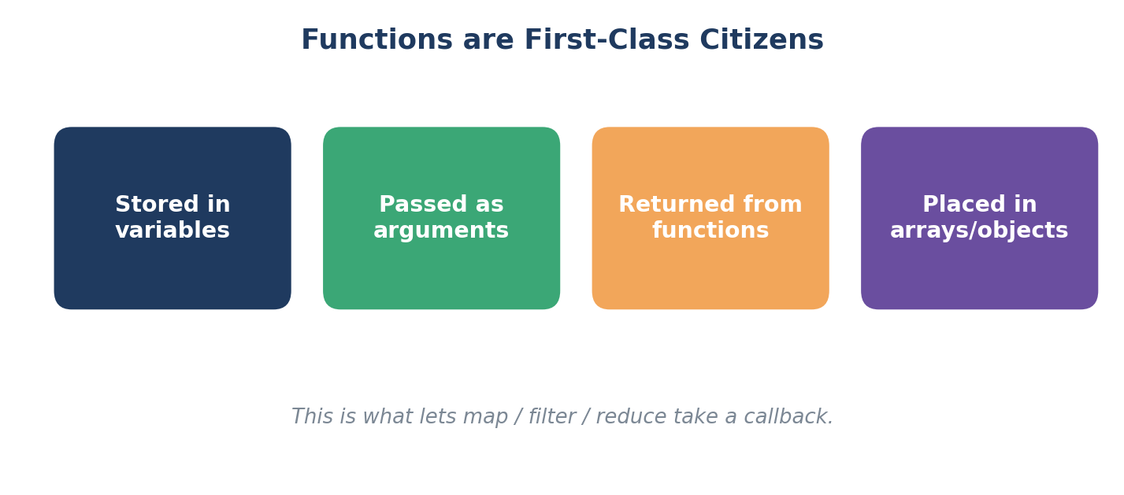
Day 5 — Functional JavaScript: Higher-Order Array Methods
Week 2 · Day 5
1. Functions are First-Class Citizens
In JavaScript, a function is just another VALUE.
Anywhere a number or a string can go, a function can go.
MERN Stack Bootcamp · Instructor: Abid Ali
5 / 25

Slide 6
Day 5 — Functional JavaScript: Higher-Order Array Methods
Week 2 · Day 5
1. Higher-Order Function (HOF) — the enabler of today
A HOF either TAKES a function as an argument, or RETURNS one.
// 1. Stored in a variable
const greet = (name) => `Hello, ${name}!`;
// 2. Passed as an argument <-- this is the HOF pattern
function twice(fn, x) { return fn(fn(x)); }
twice((n) => n + 1, 5); // 7
// 3. Returned from a function (a function factory)
const multiplyBy = (n) => (x) => x * n;
const double = multiplyBy(2);
double(21); // 42
Every method today (map / filter / reduce / …) is a higher-order function.
MERN Stack Bootcamp · Instructor: Abid Ali
6 / 25

Slide 7
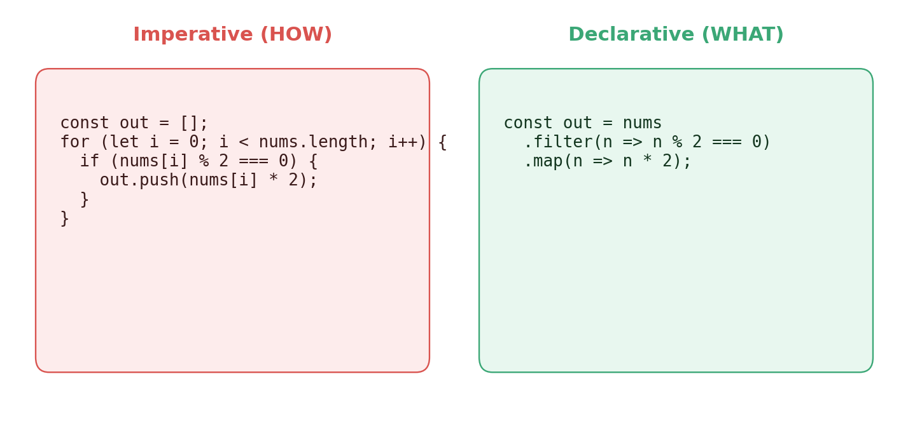
Day 5 — Functional JavaScript: Higher-Order Array Methods
Week 2 · Day 5
2. Imperative vs Declarative — same result, very different code
• Declarative = less noise — eyes read intent, not i++ / length.
• Pipelines compose: add another .filter / .map / .sort without breakage.
• Inputs stay immutable — far fewer bugs elsewhere in the program.
MERN Stack Bootcamp · Instructor: Abid Ali
7 / 25

Slide 8
Day 5 — Functional JavaScript: Higher-Order Array Methods
Week 2 · Day 5
3. forEach — iteration without a result
• Runs a callback once per element.
• Returns undefined — its only job is a SIDE EFFECT.
• Does NOT support break / continue / return-to-break.
• Does NOT wait for async callbacks.
const users = ['Ali', 'Sara', 'Umar'];
users.forEach((user, index) => {
console.log(`${index + 1}. ${user}`);
});
// 1. Ali
// 2. Sara
// 3. Umar
Heads-up — arr.forEach(async fn) is a classic bug. The outer loop finishes before any async callback resolves. Use for…of with await instead.
MERN Stack Bootcamp · Instructor: Abid Ali
8 / 25

Slide 9
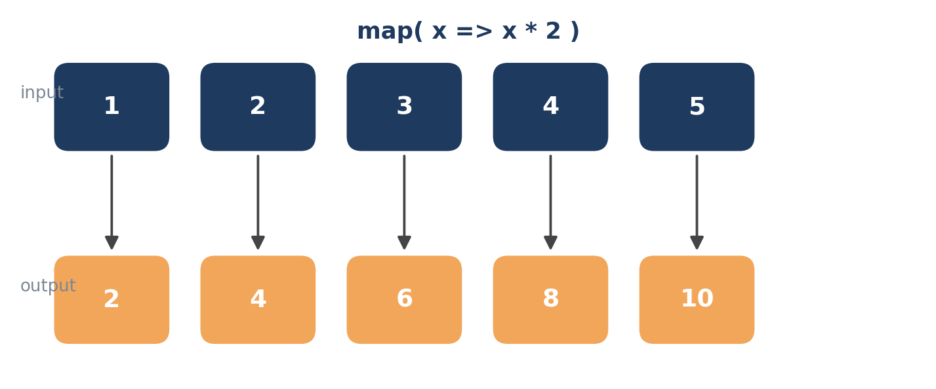
Day 5 — Functional JavaScript: Higher-Order Array Methods
Week 2 · Day 5
4. map — transform each element 1-to-1
• Builds a NEW array of the SAME length.
• Callback receives (element, index, array).
• Pure — original array is untouched.
MERN Stack Bootcamp · Instructor: Abid Ali
9 / 25

Slide 10
Day 5 — Functional JavaScript: Higher-Order Array Methods
Week 2 · Day 5
4. map — everyday examples
const nums = [1, 2, 3, 4, 5];
const doubled = nums.map(n => n * 2);
// [2, 4, 6, 8, 10]
// React-style: list of objects -> list of options
const users = [
{ id: 1, name: 'Ali' },
{ id: 2, name: 'Sara' },
];
const options = users.map(u => ({
value: u.id,
label: u.name.toUpperCase(),
}));
MERN Stack Bootcamp · Instructor: Abid Ali
10 / 25

Slide 11
Day 5 — Functional JavaScript: Higher-Order Array Methods
Week 2 · Day 5
4. map — the two bugs you WILL hit
Gotcha #1 — forgetting to return from a block body
// BUG — every element becomes undefined
nums.map(n => { n * 2; }); // [undefined, ...]
// FIX — concise body OR explicit return
nums.map(n => n * 2);
nums.map(n => { return n * 2; });
Gotcha #2 — using map for a side effect
If you are not using the returned array, you are lying to the reader of your code. Use forEach (or a for loop) for pure side effects.
MERN Stack Bootcamp · Instructor: Abid Ali
11 / 25

Slide 12
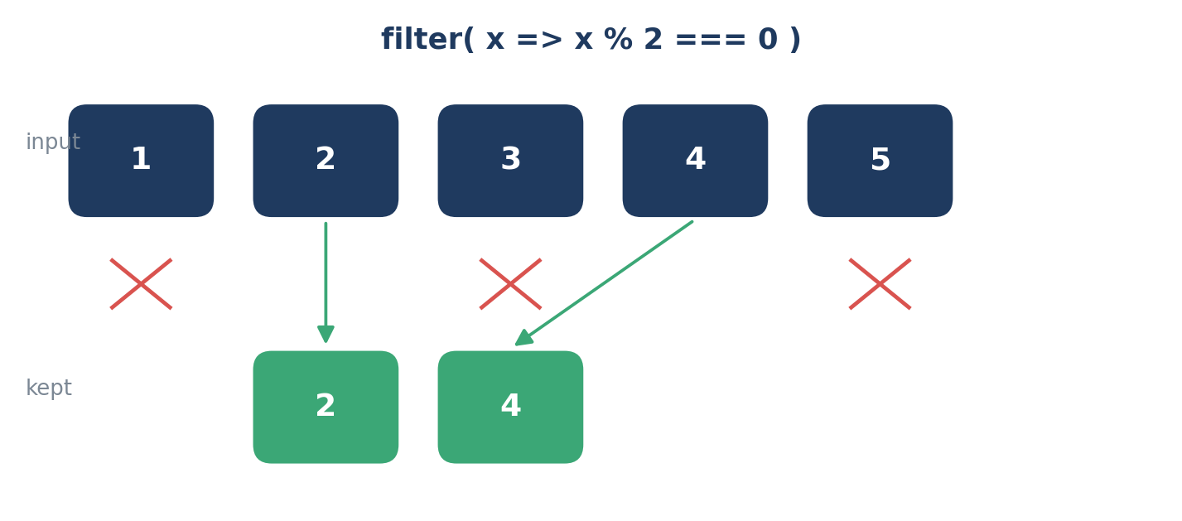
Day 5 — Functional JavaScript: Higher-Order Array Methods
Week 2 · Day 5
5. filter — keep what passes a test
• Keeps only items for which the predicate is TRUTHY.
• Output length ≤ input length — may be 0.
• Empty result is [] — never undefined (matters for chains!).
MERN Stack Bootcamp · Instructor: Abid Ali
12 / 25

Slide 13
Day 5 — Functional JavaScript: Higher-Order Array Methods
Week 2 · Day 5
5. filter — everyday examples
const products = [
{ name: 'Laptop', price: 1200, inStock: true },
{ name: 'Mouse', price: 25, inStock: true },
{ name: 'Monitor', price: 300, inStock: false },
{ name: 'Keyboard', price: 80, inStock: true },
];
const available = products.filter(p => p.inStock);
const cheap = products.filter(p => p.price < 100);
// combine predicates
const cheapAndAvailable = products.filter(
p => p.inStock && p.price < 100
);
// quick trick: drop falsy values
[1, null, 'a', 0, undefined, 'b'].filter(Boolean); // [1, 'a', 'b']
MERN Stack Bootcamp · Instructor: Abid Ali
13 / 25

Slide 14
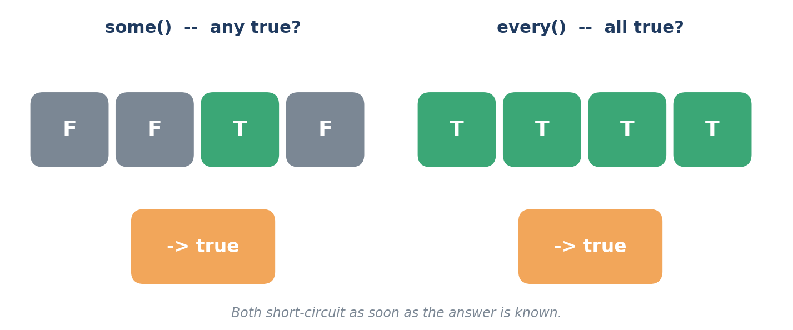
Day 5 — Functional JavaScript: Higher-Order Array Methods
Week 2 · Day 5
6. some & every — quick boolean answers
• some() — true if AT LEAST ONE element passes (OR).
• every() — true only if ALL elements pass (AND).
• Both SHORT-CIRCUIT — as fast as a hand-written loop.
MERN Stack Bootcamp · Instructor: Abid Ali
14 / 25

Slide 15
Day 5 — Functional JavaScript: Higher-Order Array Methods
Week 2 · Day 5
6. some & every — code & edge cases
const cart = [
{ name: 'Book', qty: 2 },
{ name: 'Pen', qty: 0 },
{ name: 'Eraser', qty: 5 },
];
cart.some(item => item.qty === 0); // true -> at least one OOS
cart.every(item => item.qty > 0); // false -> not all stocked
// form validation
const allFilled = [username, email, password]
.every(f => f.trim() !== '');
// MEMORISE these empty-array results
[].some(x => x); // false
[].every(x => x); // true
MERN Stack Bootcamp · Instructor: Abid Ali
15 / 25

Slide 16
Day 5 — Functional JavaScript: Higher-Order Array Methods
Week 2 · Day 5
7. find & findIndex — the first match
• find() — returns the ELEMENT, or undefined.
• findIndex() — returns the POSITION, or -1.
• Both stop on the first match — faster than filter()[0].
const users = [
{ id: 1, name: 'Ali' },
{ id: 2, name: 'Sara' },
{ id: 3, name: 'Umar' },
];
users.find(u => u.id === 2); // { id: 2, name: 'Sara' }
users.findIndex(u => u.id === 2); // 1
users.find(u => u.id === 99); // undefined
// pairs nicely with optional chaining
const sara = users.find(u => u.name === 'Sara');
console.log(sara?.id ?? 'not found');
MERN Stack Bootcamp · Instructor: Abid Ali
16 / 25

Slide 17
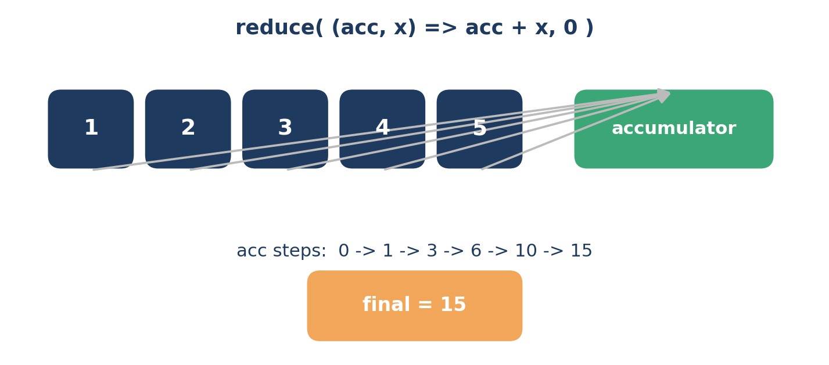
Day 5 — Functional JavaScript: Higher-Order Array Methods
Week 2 · Day 5
8. reduce — the Swiss Army knife
• Collapses an array to ONE value — number, string, object, array.
• Reducer signature: (acc, element) => newAcc.
• Always pass an INITIAL value. Always.
MERN Stack Bootcamp · Instructor: Abid Ali
17 / 25

Slide 18
Day 5 — Functional JavaScript: Higher-Order Array Methods
Week 2 · Day 5
8. reduce — simple aggregates
const nums = [1, 2, 3, 4, 5];
// sum
nums.reduce((acc, n) => acc + n, 0); // 15
// max without Math.max
nums.reduce((max, n) => n > max ? n : max); // 5 (no seed: uses [0])
// min price across products
products.reduce(
(cheap, p) => p.price < cheap.price ? p : cheap
);
No initial value? First call uses arr[0] as the seed and SKIPS arr[0] — dangerous when the array may be empty.
MERN Stack Bootcamp · Instructor: Abid Ali
18 / 25

Slide 19
Day 5 — Functional JavaScript: Higher-Order Array Methods
Week 2 · Day 5
8. reduce — grouping into an object
const products = [
{ name: 'Laptop', cat: 'tech' },
{ name: 'Book', cat: 'reading' },
{ name: 'Monitor', cat: 'tech' },
];
const byCat = products.reduce((acc, p) => {
(acc[p.cat] ||= []).push(p);
return acc;
}, {});
// { tech: [Laptop, Monitor], reading: [Book] }
MERN Stack Bootcamp · Instructor: Abid Ali
19 / 25

Slide 20
Day 5 — Functional JavaScript: Higher-Order Array Methods
Week 2 · Day 5
9. sort — ordering (carefully!)
• sort() is DIFFERENT — it MUTATES the array in place.
• Without a comparator, it sorts by STRING order (surprise!).
• Comparator contract: negative -> a first, positive -> b first, zero -> equal.
// The classic trap
[10, 2, 30, 4].sort(); // [10, 2, 30, 4] compared as strings
// The fix
[10, 2, 30, 4].sort((a, b) => a - b); // [2, 4, 10, 30]
[10, 2, 30, 4].sort((a, b) => b - a); // [30, 10, 4, 2]
// Sorting objects
products.sort((a, b) => a.price - b.price);
products.sort((a, b) => a.name.localeCompare(b.name));
Inside React state? Copy first: [...items].sort(...) — otherwise you mutate state.
MERN Stack Bootcamp · Instructor: Abid Ali
20 / 25

Slide 21
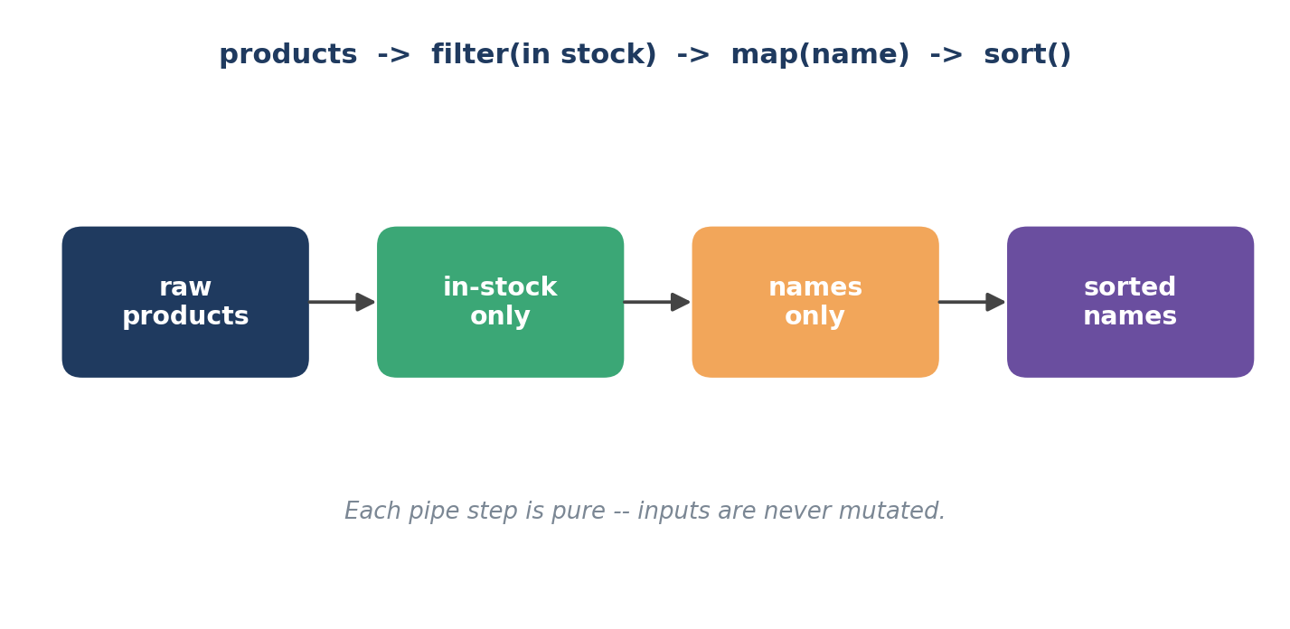
Day 5 — Functional JavaScript: Higher-Order Array Methods
Week 2 · Day 5
10. The real power — chaining pure steps
map, filter, slice, sort (+copy) all return ARRAYS — so we can pipe them.
MERN Stack Bootcamp · Instructor: Abid Ali
21 / 25

Slide 22
Day 5 — Functional JavaScript: Higher-Order Array Methods
Week 2 · Day 5
10. Chaining — a realistic example
"Top-3 most expensive IN-STOCK laptop names, UPPER-CASED"
const top3 = products
.filter(p => p.cat === 'laptop' && p.inStock)
.sort((a, b) => b.price - a.price)
.slice(0, 3)
.map(p => p.name.toUpperCase());
// ['MACBOOK PRO', 'DELL XPS', 'LENOVO YOGA']
If a step feels magical, break it out and name it: const inStockLaptops = products.filter(...). Named intermediates are free documentation.
MERN Stack Bootcamp · Instructor: Abid Ali
22 / 25

Slide 23
Day 5 — Functional JavaScript: Higher-Order Array Methods
Week 2 · Day 5
11. Performance & pitfalls
• Each step in a chain is a full O(n) pass. For arrays < 10,000 items — readability wins, every time.
• Hot path? One for-loop fuses passes and avoids intermediate arrays.
• forEach / map do NOT wait for async — use for…of + await, or Promise.all(arr.map(asyncFn)).
• Non-mutating: map, filter, slice, concat, flat, reduce, …
• Mutating (beware!): sort, reverse, splice, push, pop — copy first.
MERN Stack Bootcamp · Instructor: Abid Ali
23 / 25

Slide 24
Day 5 — Functional JavaScript: Higher-Order Array Methods
Week 2 · Day 5
Cheat-sheet — save this image, put it on your monitor
Method | Returns | Use when you want to…
forEach | undefined | perform a side effect on each item
map | new array (same length) | transform every item 1-to-1
filter | new array (shorter) | keep items passing a predicate
find | item | undefined | get the FIRST match
findIndex | number | get the POSITION of the first match
some | boolean | ask: "is ANY item…?"
every | boolean | ask: "are ALL items…?"
reduce | any single value | collapse many items into one
sort | same array (mutated!) | order items (always pass comparator)
MERN Stack Bootcamp · Instructor: Abid Ali
24 / 25

Slide 25
Time to get your hands dirty
Open the lab manual and practise everything on a realistic e-commerce catalogue.
Lab file:
LAB MANUAL DAY 5 - ARRAY METHODS.pdf
Coming next: fetching JSON + rendering — this exact pipeline, inside a React component.
Instructor: Abid Ali · MERN Stack Bootcamp · Week 2 · Day 5

